Slide 1


Technology Application Project
Engineray Presentation
Student Name: Chenyuan Zhai
Student Number: 103518195

Slide 2
catalogue
1. Project Concepts
1. My project requirement(s)
2. Research
3. Go through your work in detail (code etc)
[any extra experimentation, innovation you did]
4. Demonstrate
5. User manual walk through
6. Lessons learnt
7. Future work
(based on your work, anything else you would want to incorporate to
make the final product better)

Slide 3
Project Concepts
Prototype
Figma
Front-End developments
Web Page Design
WordPress
Coding
HTML/CSS/JAVASCRIPT, PHP, MYSQL

Slide 4
Project Requirements - company
Companies (User) requirements
- Authentication of the user (engineers and companies) and provide unique data based on login
- Be able to enter data on requirements, such as number of engineers needed, skills required, preferred starting date, years of experience, preferred budget.
- View profiles of each engineer.
- Be able to filter database according to engineer’s availability, skillset, location, experience and any other criteria. (back-end)
- Profiles need to be ordered with respect to recommendations based on customer’s persona and (optional) job description text. (back-end)
- Search function and filters should be available on the webpage. (mixed)
- Watch problem solving vetting video. (mixed)
- Get domain knowledge performance metrics. (mixed)
- Watch mock interview vetting video - Calendly (API) (mixed)
- Be able to schedule an interview through EngineRay (front-end)
- Be able to communicate with the engineer on the platform letting them know on how to prep for the interview. (research the chat box is the backend or frontend)
- Be able to shortlist, accept or reject a candidate. (So they are filtered out if the company comes back to the database page). (back-end)
- Be able to pay monthly invoice to EngineRay (e.g. via integration with Stripe).
- Be able to provide feedback on the candidate. (front-end)
- Be able to reach EngineRay support team in case help needed. (front-end)
- Companies should not be able to view any contact information for the engineers other than the interview request through EngineRay. (role - )
- Be able to digitally sign the contract with EngineRay. (API - doc Sign). ()

Slide 5
Project Requirements
Project Requirements - Admin
EngineRay (Admin) requirements:
- Be able to view full database of engineers including profile status (just started, inactive, undergoing vetting, fully vetted, profile fully approved, interviewing, hired).
- Be able to flag and blacklist profiles.
- Be able to view full database of companies that have signed up on the platform along with their status (just signed up, evaluating profiles. interviewing, have hired candidate).
- Be a super user, meaning that admin can do everything that Companies (user) can do or an Engineer (user) can do.

Slide 6
Research
Design pages using WordPress template with editor
Define Primary Key/Foreign Key, different data type like BLOB, BIGINT, Set auto_increment
Using WordPress to build the website
HTML <div> css settings, hign-level css settings, like :a hover, opacity, cursor etc, transform 1s etc.
Research
SQL Query, Creating Localhost Database
PHP connection to the localhost database using require_once (“.php”), define $values, echo [‘$values’], using if(empty()) to validation <input>data, session_start(), two different functions Mysqli_connect & PDO to fetch data etc.
Learning Front-end Languages
Javascript to create the dynamic reflection between two pages, using id from html to return getElementById data, define new function and var etc

Slide 7
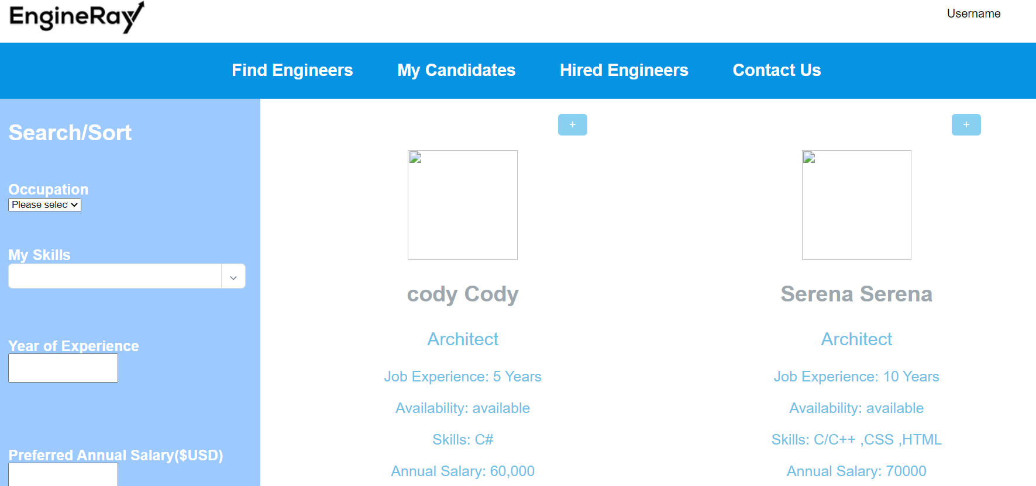
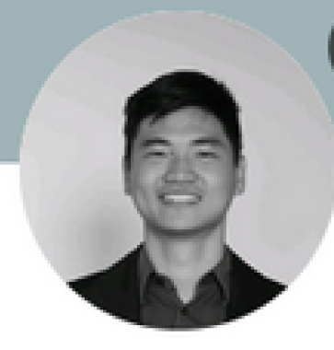
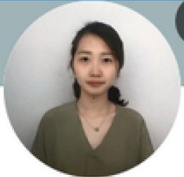
3. Go through your work in detail (code etc) [any extra experimentation, innovation I did]
/Company sides – find engineer.php (page)

Slide 8
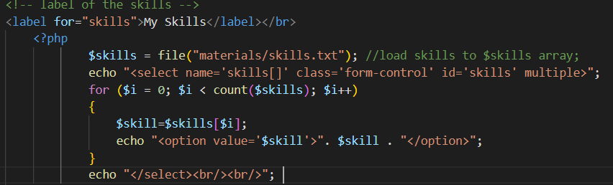
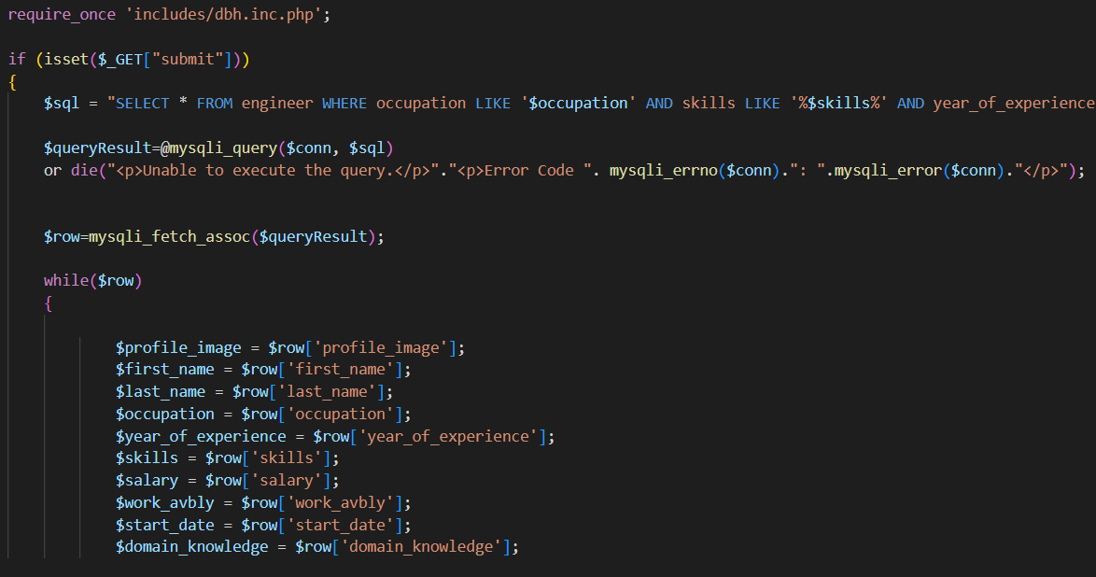
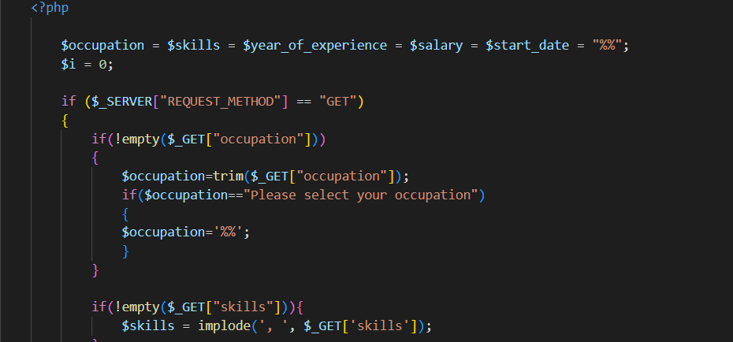
3. Go through your work in detail (code etc) [any extra experimentation, innovation I did]
/Company sides – find engineer.php (core codes)
Sidebar label ‘skills’ using txt to the selections
Save data to localhost database
Validation <input> data

Slide 9
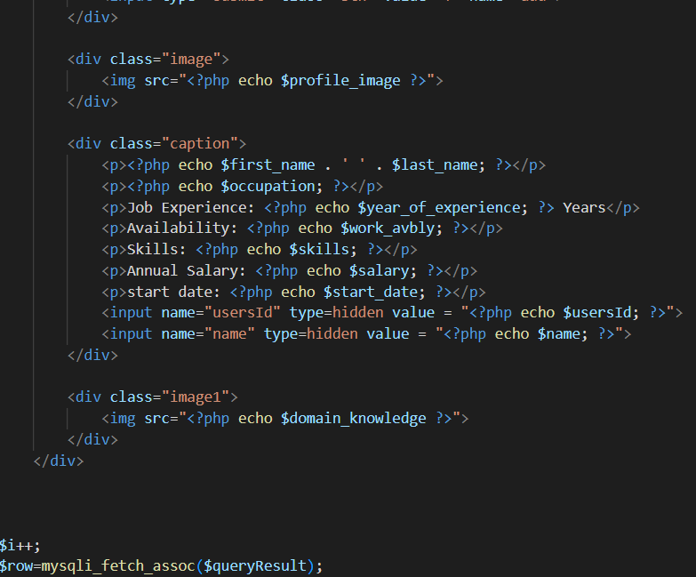
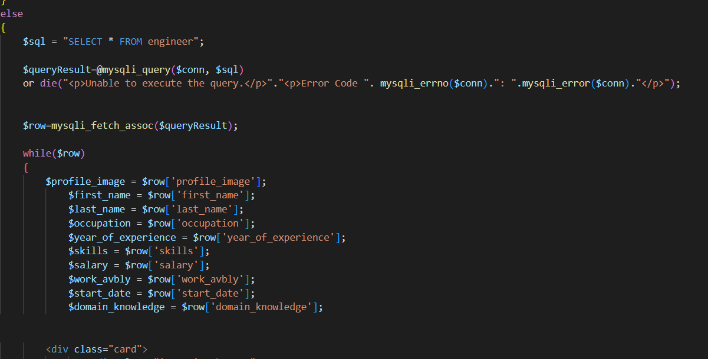
3. Go through your work in detail (code etc) [any extra experimentation, innovation I did]
/Company sides – find engineer.php (core codes)
“IF Else” loop is to make sure when begin to research, the page will display all engineer data rather than block.
“IF Else” loop is to make sure when begin to research, the page will display all engineer data rather than block. i++ is make the loop can stop not operating forever.
Display data included image to the main_content right area

Slide 10
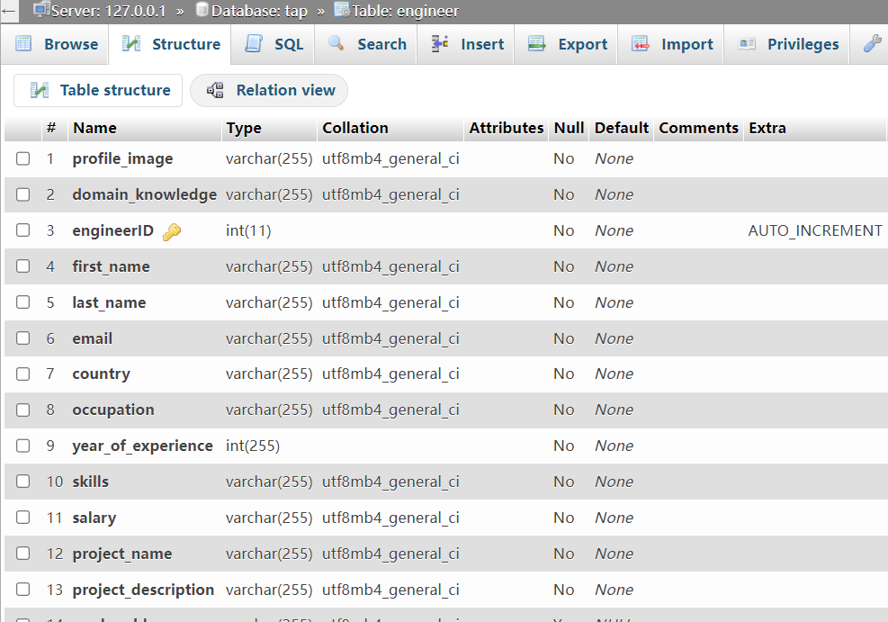
3. Go through your work in detail (code etc) [any extra experimentation, innovation I did]
/Company sides – find engineer.php (database)
Create engineer table:
CREATE TABLE engineer(
engineerID int NOT NULL AUTO_INCREMENT,
first_name varchar(255) NOT NULL,
last_name varchar(255) NOT NULL,
email varchar(255) NOT NULL,
country varchar(255) NOT NULL,
occupation varchar(255) NOT NULL,
year_of_experience varchar(255) NOT NULL,
skills varchar(255) NOT NULL,
salary varchar(255) NOT NULL,
project_name varchar(255) NOT NULL,
project_description varchar(255) NOT NULL,
work_avbly varchar(255),
notice_period varchar(255),
start_date varchar(255),
objectID varchar(255),
resumeID varchar(255),
PRIMARY KEY(engineerID),
FOREIGN KEY (objectID) REFERENCES profile_image(objectID));

Slide 11
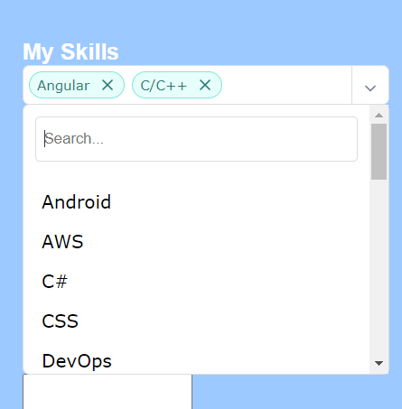
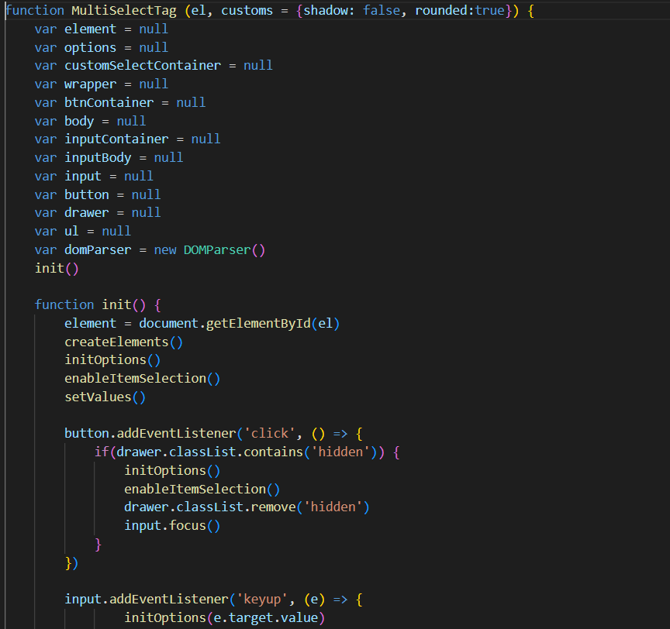
3. Go through your work in detail (code etc) [any extra experimentation, innovation I did]
/Company sides – find engineer.php (research multiple skills)
Javascript addEventListener for multiple selections

Slide 12
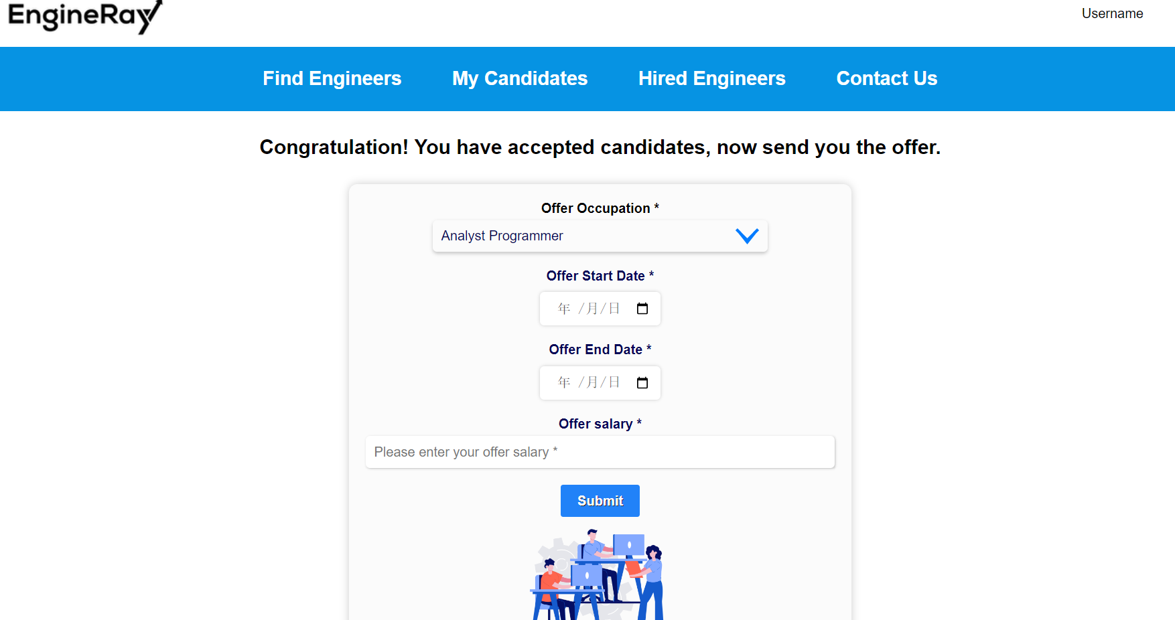
3. Go through your work in detail (code etc) [any extra experimentation, innovation I did]
/Company sides – send offer.php (page)

Slide 13
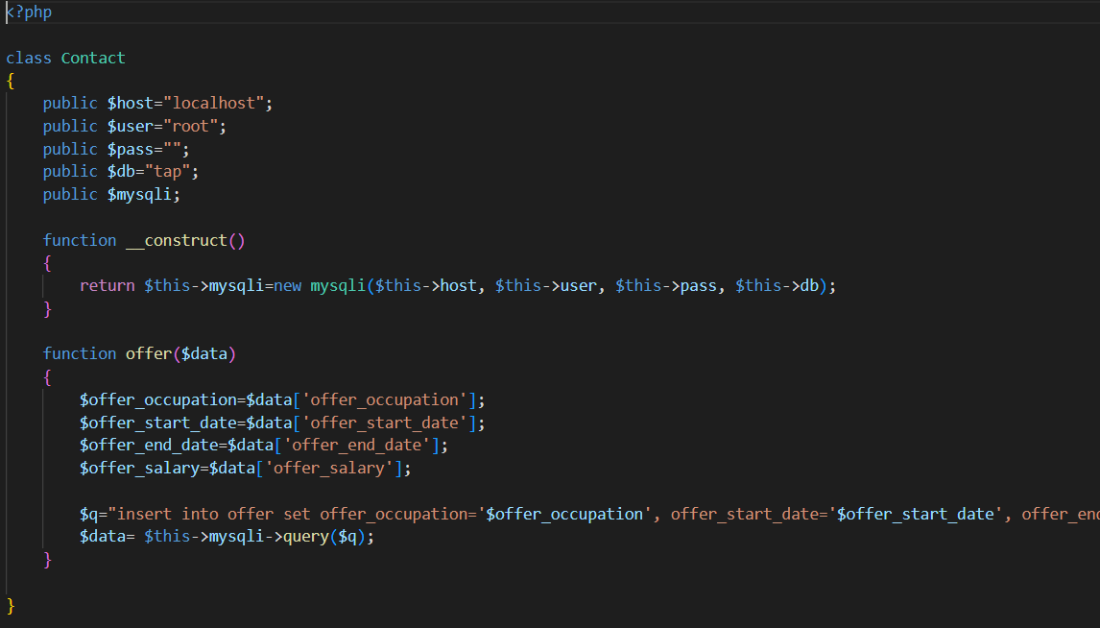
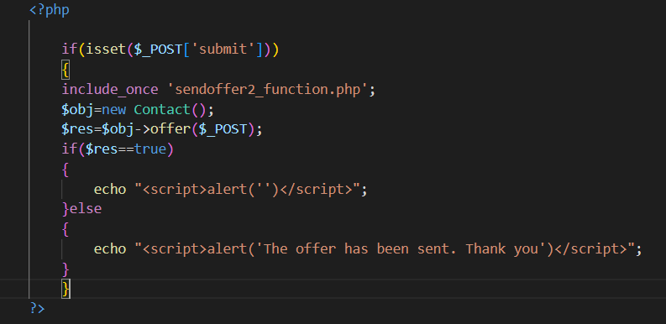
3. Go through your work in detail (code etc) [any extra experimentation, innovation I did]
/Company sides – send offer.php (core code)
Link to database

Slide 14
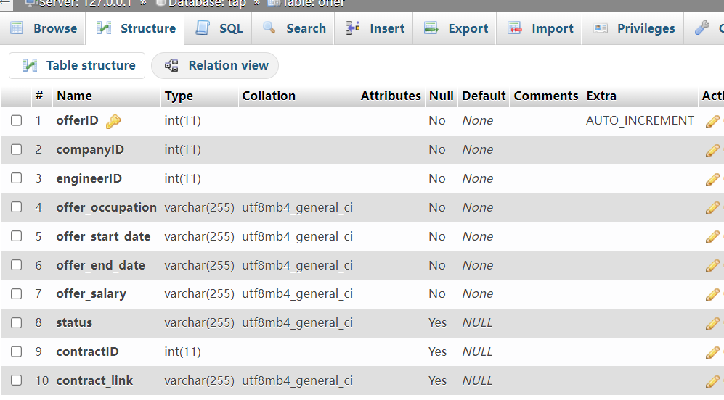
3. Go through your work in detail (code etc) [any extra experimentation, innovation I did]
/Company sides – send offer.php (database)
CREATE TABLE offer(
offerID int NOT NULL PRIMARY KEY AUTO_INCREMENT,
companyID int NOT NULL,
engineerID int NOT NULL,
offer_occupation varchar(255) NOT NULL,
offer_start_date varchar(255) NOT NULL,
offer_end_date varchar(255) NOT NULL,
offer_salary varchar(255) NOT NULL,
status varchar(255),
contractID int,
contract_link varchar(255),
FOREIGN KEY (engineerID) REFERENCES engineer(engineerID),
FOREIGN KEY (companyID) REFERENCES company(companyID))

Slide 15
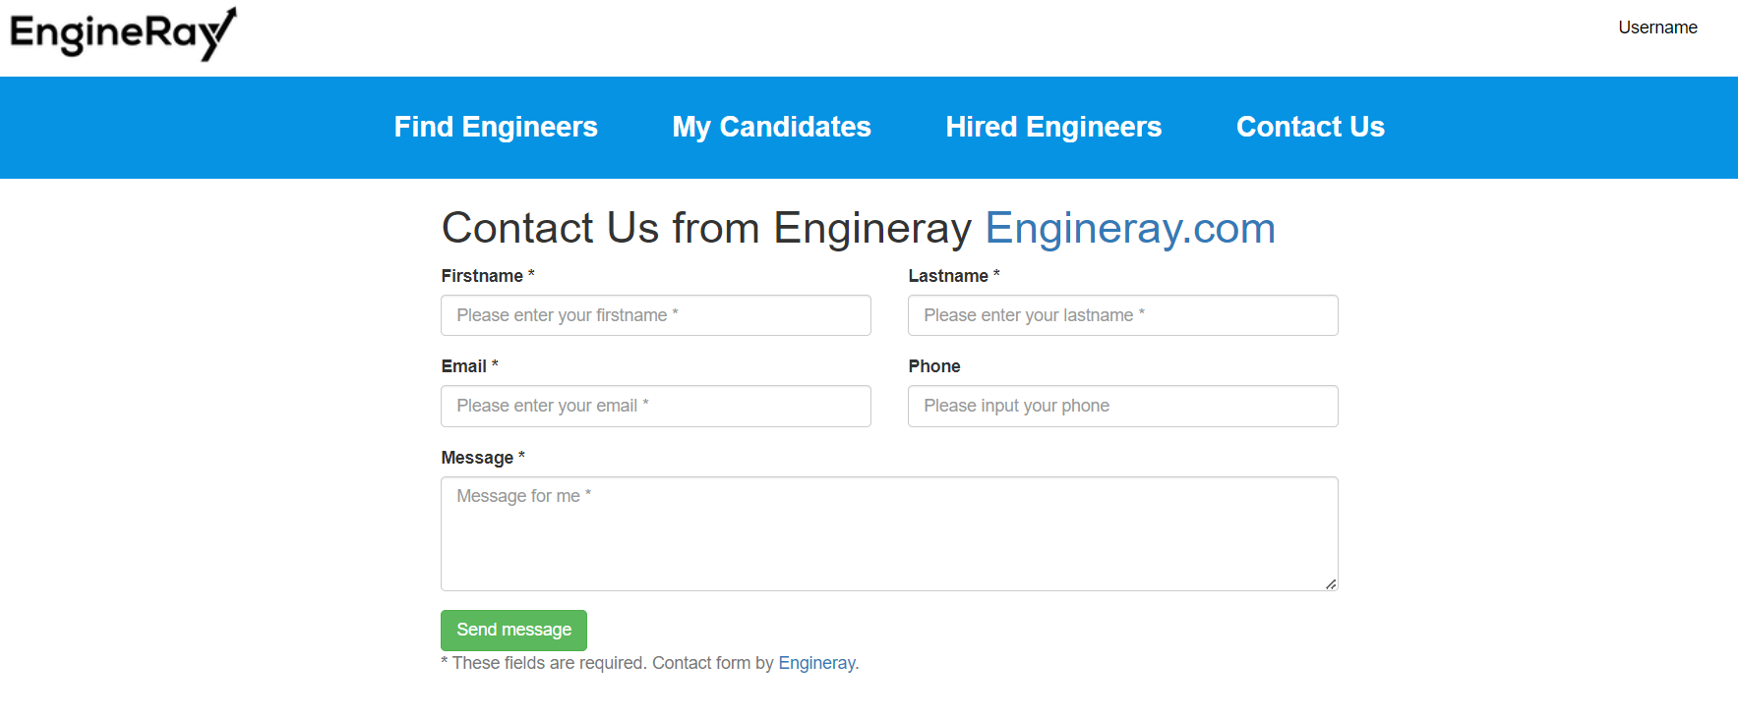
3. Go through your work in detail (code etc) [any extra experimentation, innovation I did]
/Company sides – contactus.php (page)

Slide 16
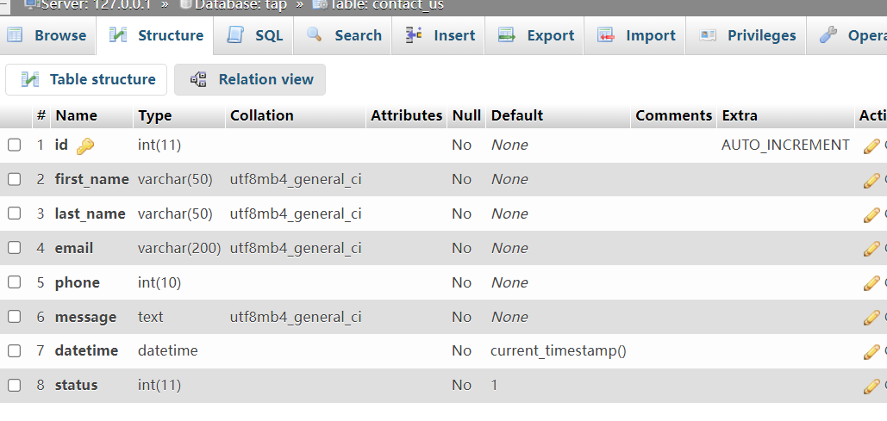
3. Go through your work in detail (code etc) [any extra experimentation, innovation I did]
/Company sides – contactus.php (database)
CREATE TABLE company(
id int NOT NULL AUTO_INCREMENT,
first_name varchar(255) NOT NULL,
last_name varchar(255) NOT NULL,
email varchar(255) NOT NULL,
phone int(10) NOT NULL,
message text(255) NOT NULL,
datetime(datetime) NOT NULL,
statusint(11) NOT NULL,
PRIMARY KEY(id));

Slide 17
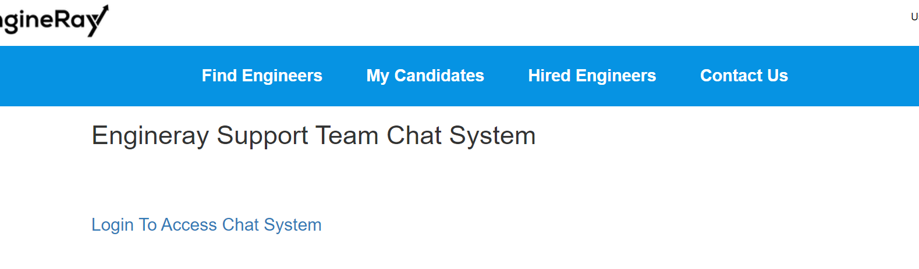
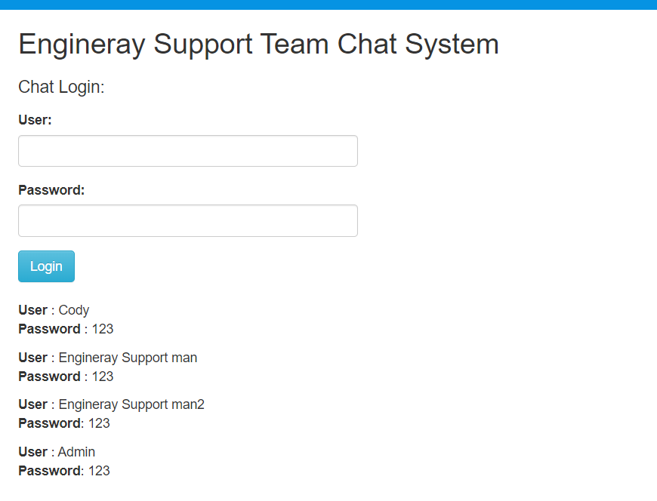
3. Go through your work in detail (code etc) [any extra experimentation, innovation I did]
/Company sides – livechat.php (live chat login page)

Slide 18
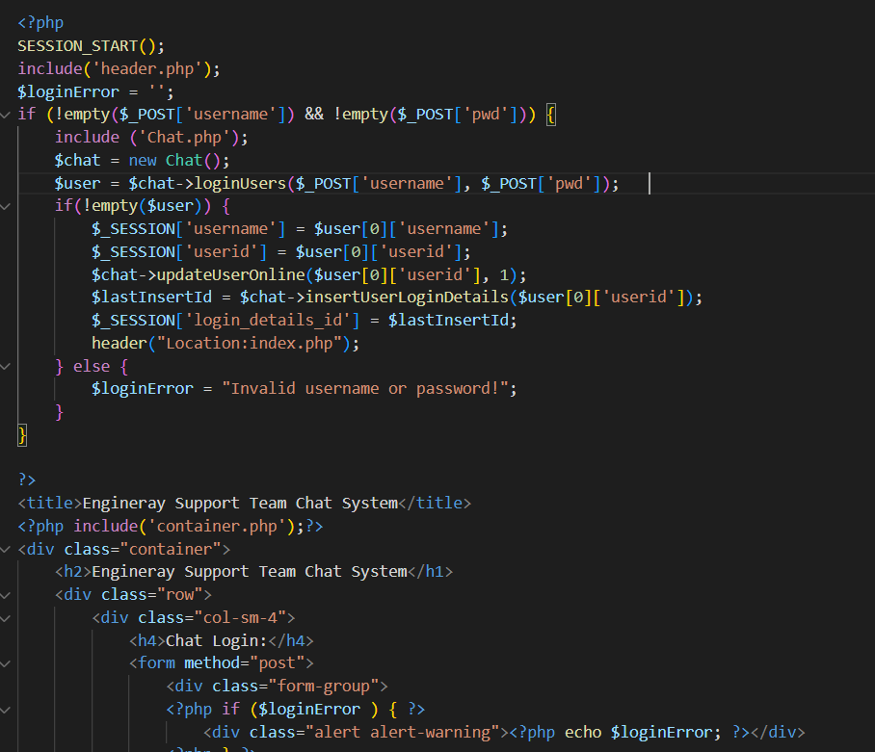
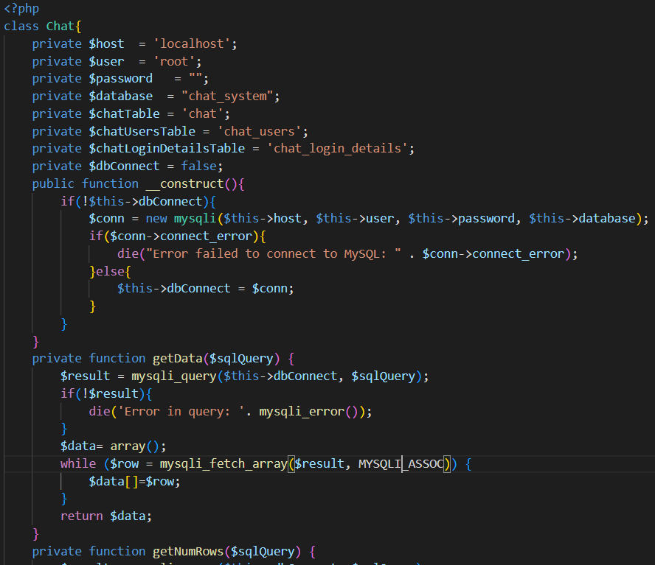
3. Go through your work in detail (code etc) [any extra experimentation, innovation I did]
/Company sides – livechat.php (core codes)
Validation login inputs
Link to chat_system database using Mysqli

Slide 19
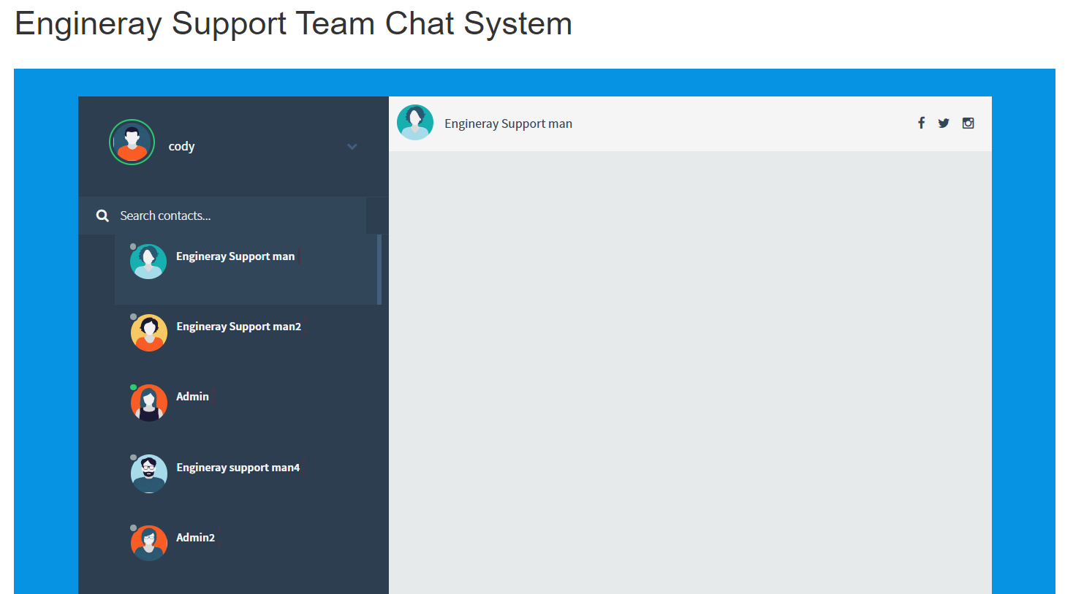
3. Go through your work in detail (code etc) [any extra experimentation, innovation I did]
/Company sides – livechat.php (chat interface)

Slide 20
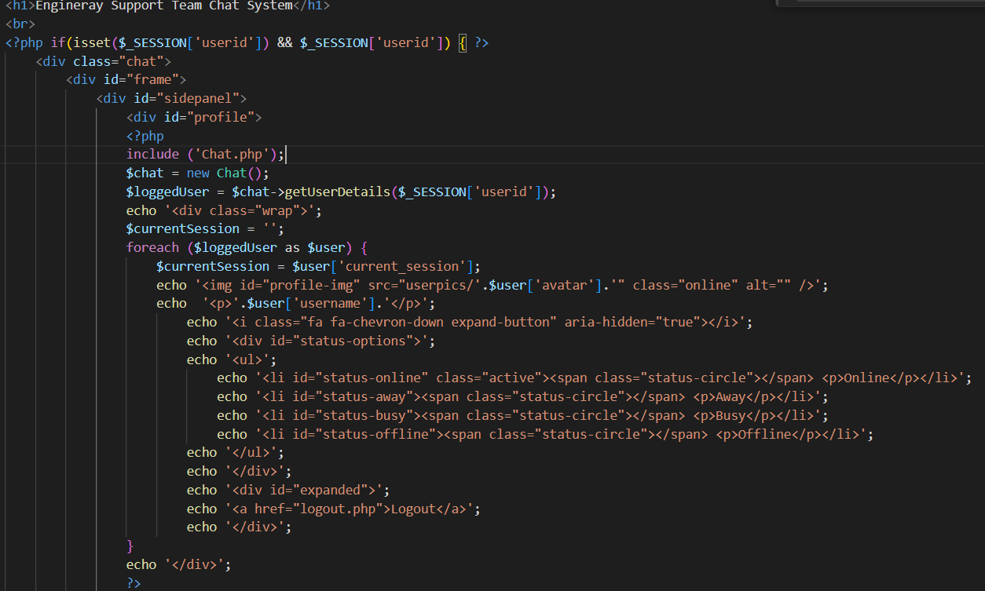
3. Go through your work in detail (code etc) [any extra experimentation, innovation I did]
/Company sides – livechat.php (core codes)
Display the users from data using echo “$”.
Link to chat.php and define a new chat variable.

Slide 21
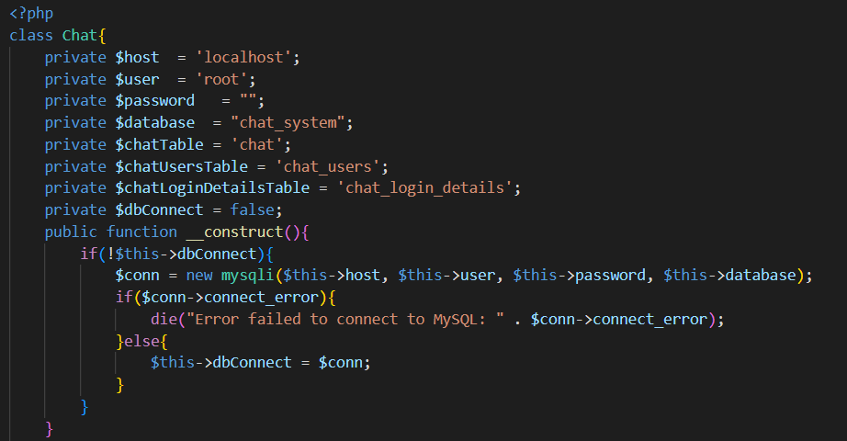
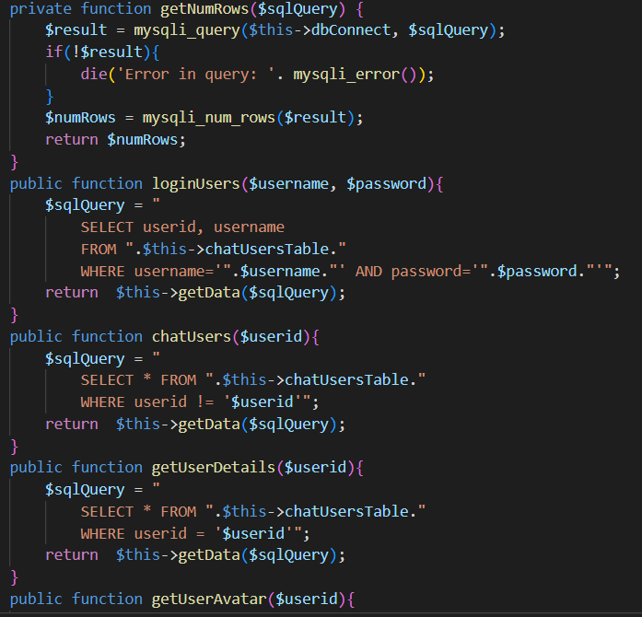
3. Go through your work in detail (code etc) [any extra experimentation, innovation I did]
/Company sides – livechat.php (core codes)
Chat.php link to back end localhost database, and validate successful or not connect the database using $conn
Retrieve data from database tables, create functions to ger userid, user images, through select * from database

Slide 22
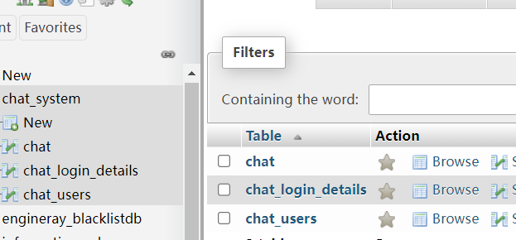
3. Go through your work in detail (code etc) [any extra experimentation, innovation I did]
/Company sides – livechat.php (database)
CREATE TABLE `chat_users` (
`userid` int(11) NOT NULL,
`username` varchar(255) NOT NULL,
`password` varchar(255) NOT NULL,
`avatar` varchar(255) NOT NULL,
`current_session` int(11) NOT NULL,
`online` int(11) NOT NULL
) ENGINE=InnoDB DEFAULT CHARSET=latin1;
INSERT INTO `chat_users` (`userid`, `username`, `password`, `avatar`, `current_session`, `online`) VALUES
(1, ‘Cody', '123', 'user1.jpg', 3, 1),
(2, ‘Engineray support man1', '123', 'user2.jpg', 1, 0),
(3, ' Engineray support man2', '123', 'user3.jpg', 1, 1),
(4, ‘Admin1', '123', 'user4.jpg', 0, 0),
(5, ‘Admin2', '123', 'user5.jpg', 0, 0);
Three table included, login details, chat records and chat users info
CREATE TABLE `chat` (
`chatid` int(11) NOT NULL,
`sender_userid` int(11) NOT NULL,
`reciever_userid` int(11) NOT NULL,
`message` text NOT NULL,
`timestamp` timestamp NOT NULL DEFAULT CURRENT_TIMESTAMP,
`status` int(1) NOT NULL
) ENGINE=InnoDB DEFAULT CHARSET=latin1;
CREATE TABLE `chat_login_details` (
`id` int(11) NOT NULL,
`userid` int(11) NOT NULL,
`last_activity` timestamp NOT NULL DEFAULT CURRENT_TIMESTAMP,
`is_typing` enum('no','yes') NOT NULL
) ENGINE=InnoDB DEFAULT CHARSET=latin1;

Slide 23
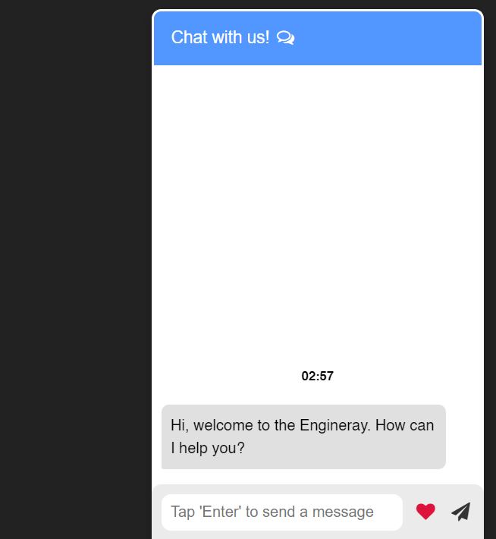
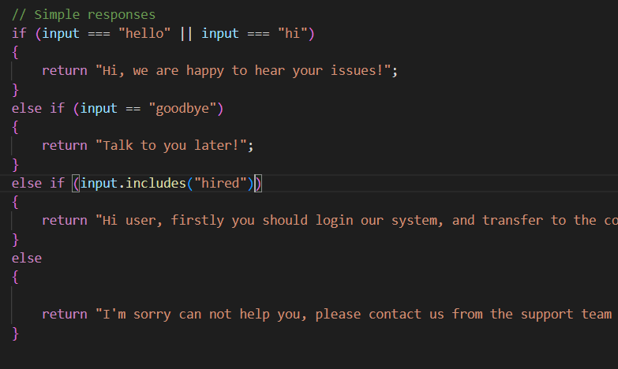
3. Go through your work in detail (code etc) [any extra experimentation, innovation I did]
/Company sides – support_team.php (plugin) - javascript
Simple chat bot to reply users question through key words or specific sentences, using if loop, if (input == “specific”) or if(input.includes(“key words”)).

Slide 24
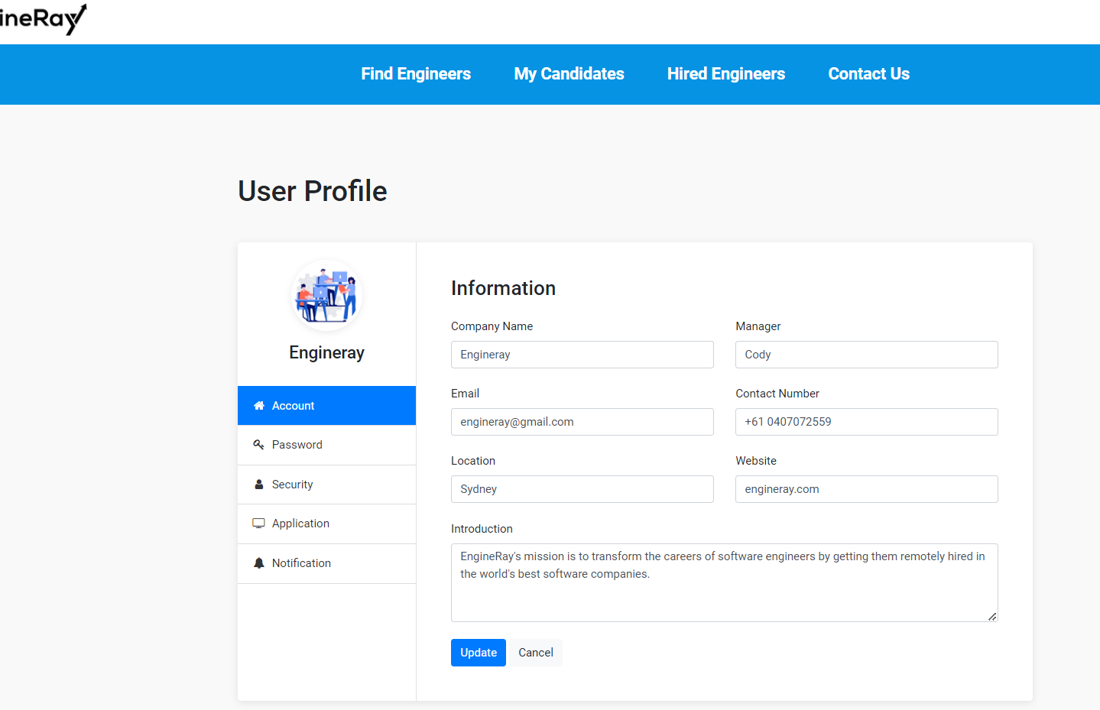
3. Go through your work in detail (code etc) [any extra experimentation, innovation I did]
/Company sides – users_profile.php (page)

Slide 25
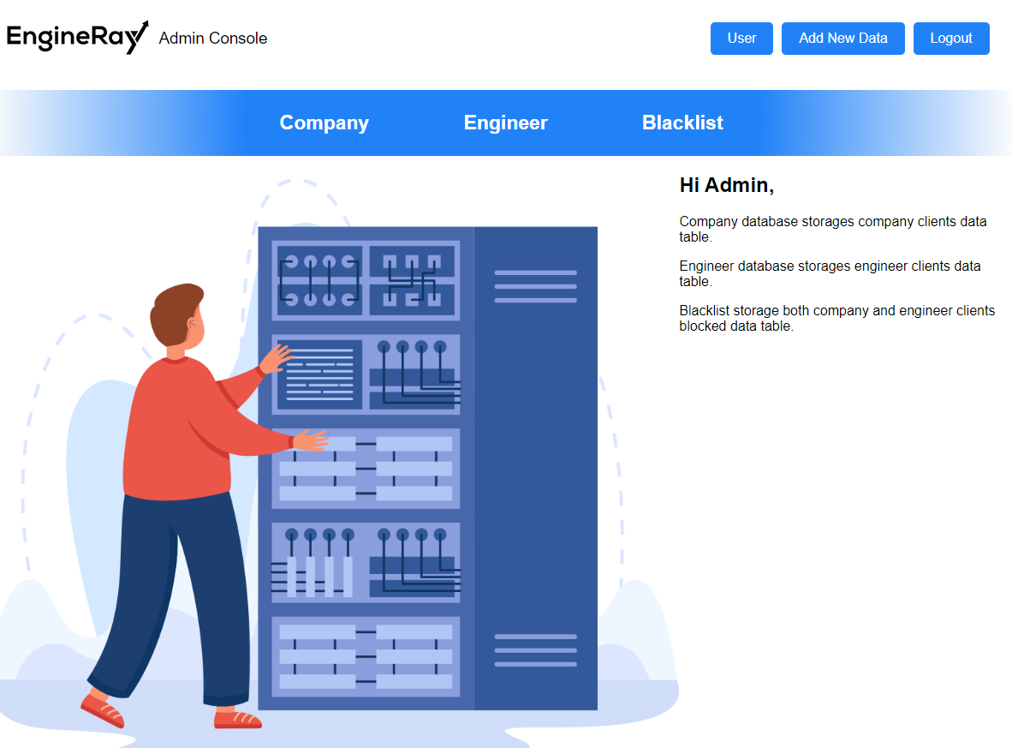
3. Go through your work in detail (code etc) [any extra experimentation, innovation I did]
/Admin Side– Dashboard (page)

Slide 26
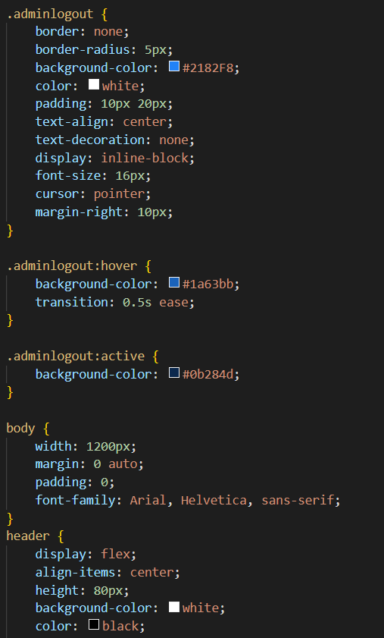
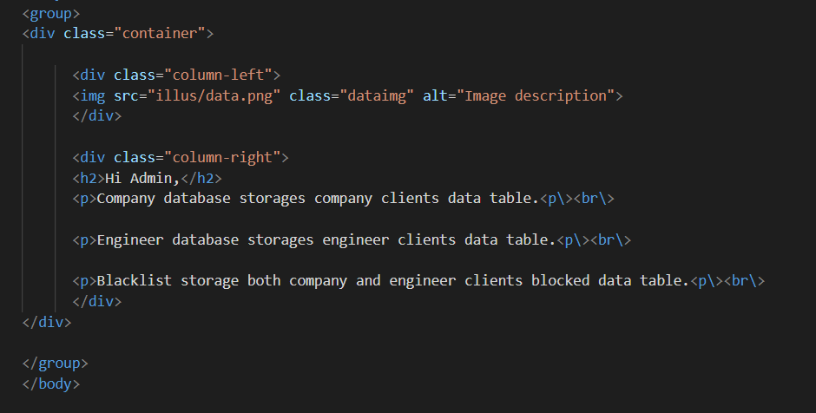
3. Go through your work in detail (code etc) [any extra experimentation, innovation I did]
/Admin Side– Dashboard (codes)
Basic html constructure, it includes the column-left <div> to display the photo, the column-right display the texts for admin.
More animate css explorations, like :active and :hover, cursor: pointer etc.

Slide 27
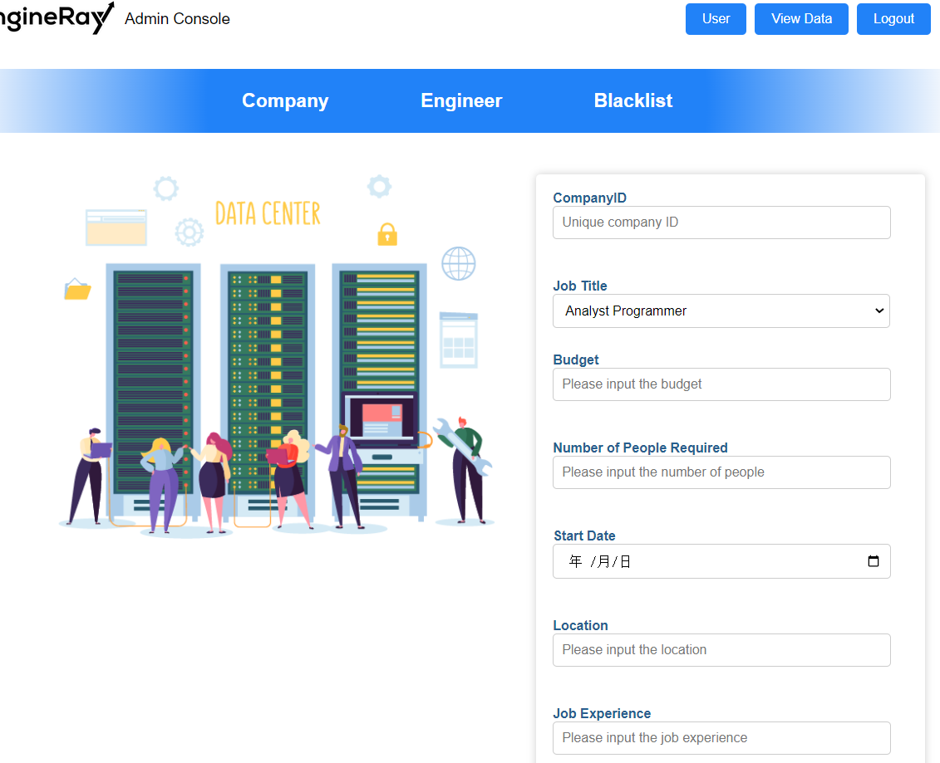
3. Go through your work in detail (code etc) [any extra experimentation, innovation I did]
/Admin Side– Company (input data table)

Slide 28
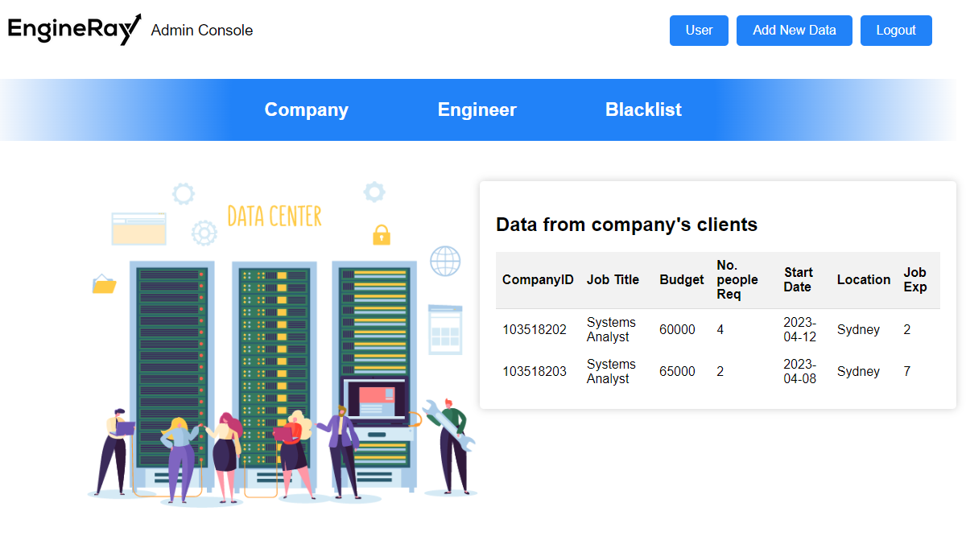
3. Go through your work in detail (code etc) [any extra experimentation, innovation I did]
/Admin Side– Company (view data table)

Slide 29
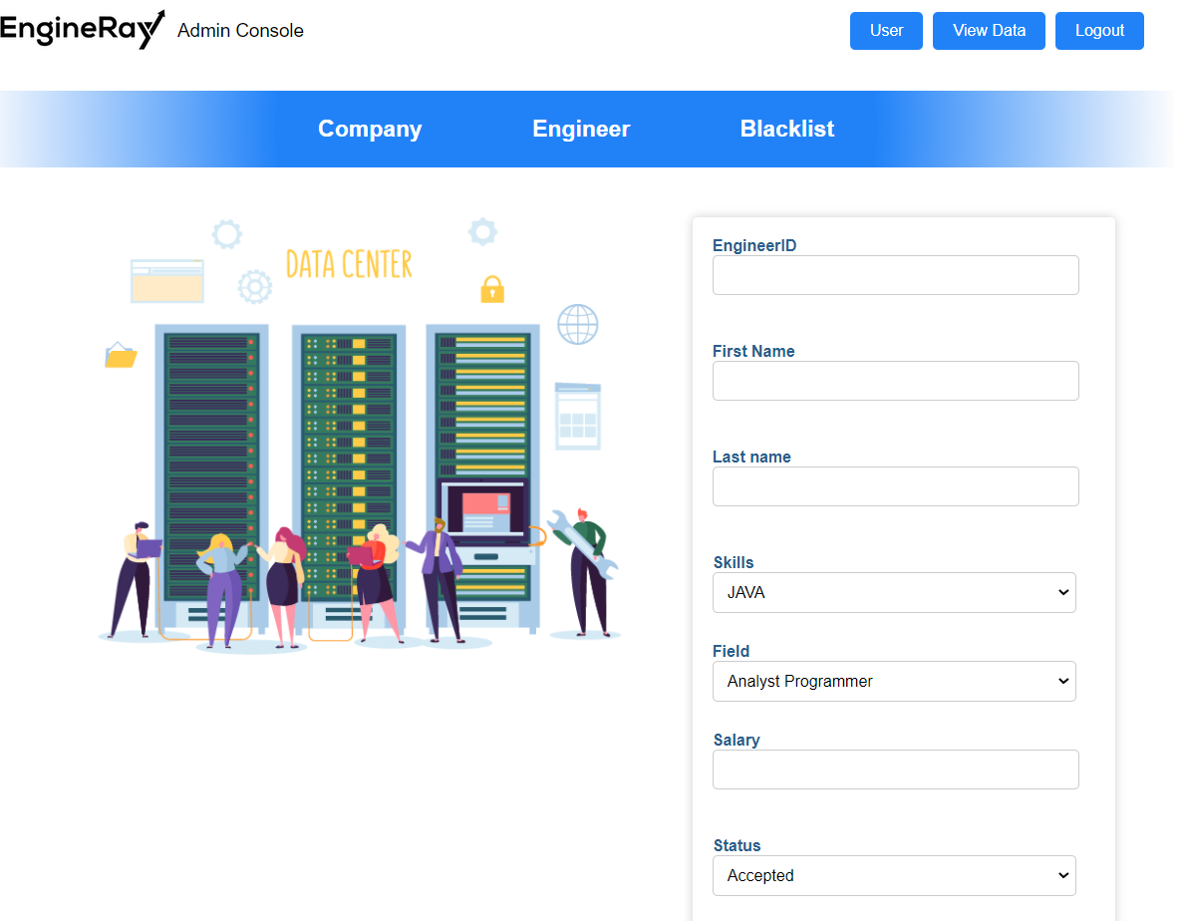
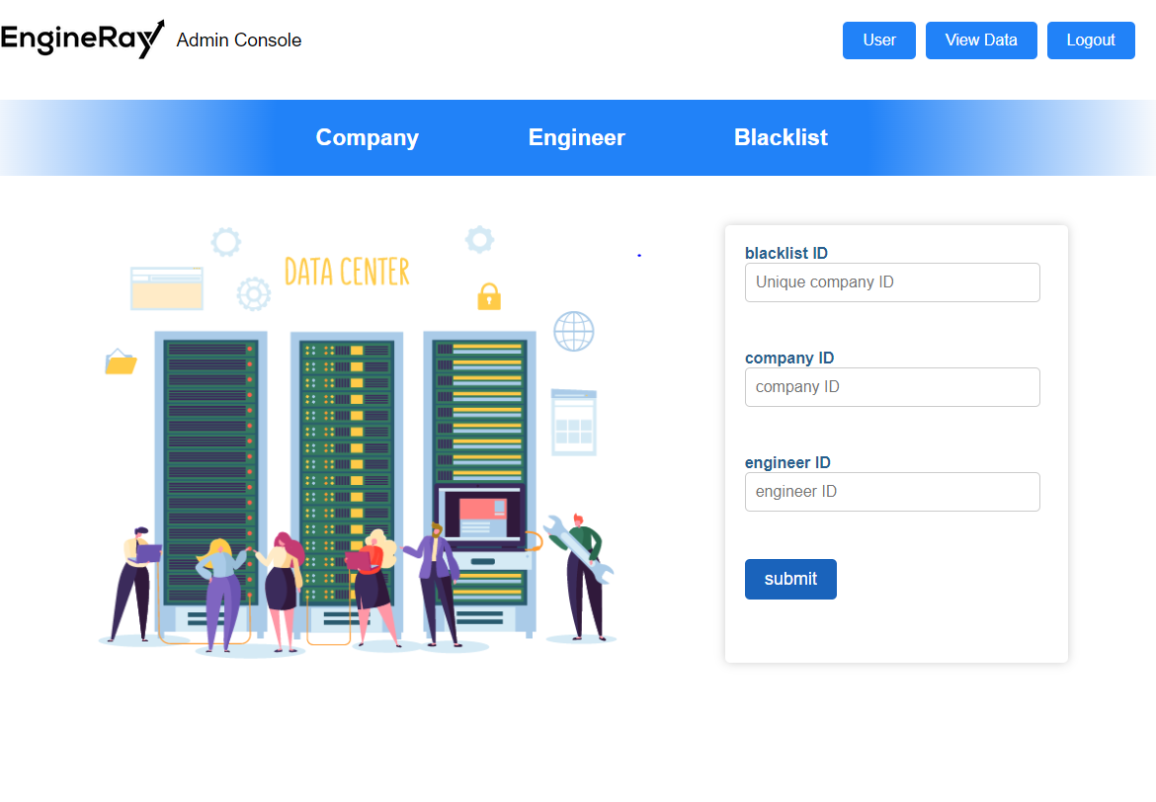
3. Go through your work in detail (code etc) [any extra experimentation, innovation I did]
/Admin Side– Engineer + Blacklist (input data table)

Slide 30
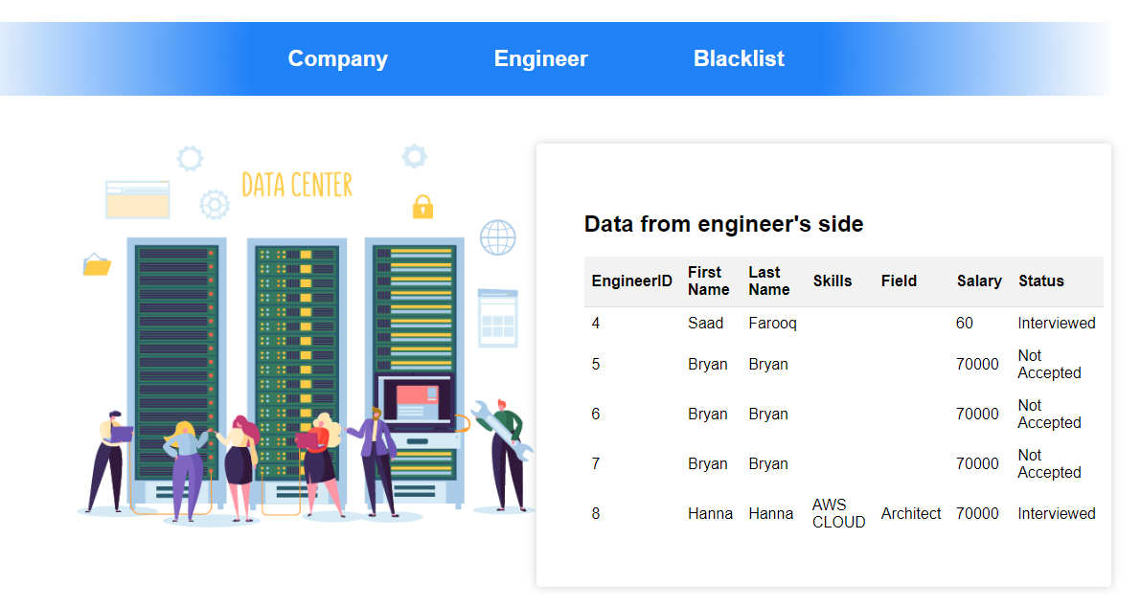
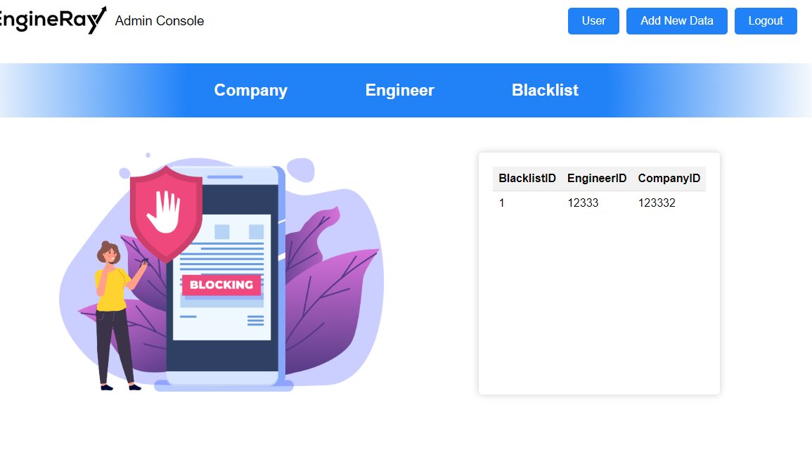
3. Go through your work in detail (code etc) [any extra experimentation, innovation I did]
/Admin Side– Engineer + Blacklist (view data table)

Slide 31
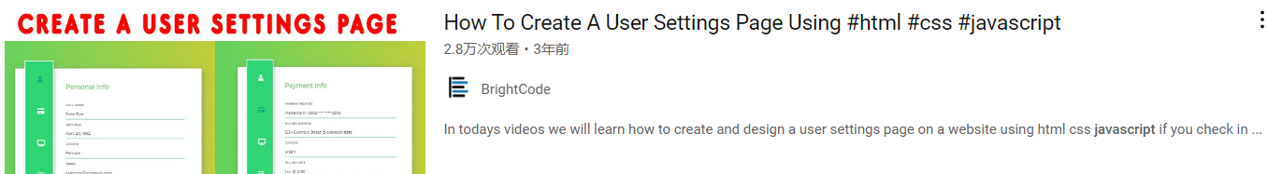
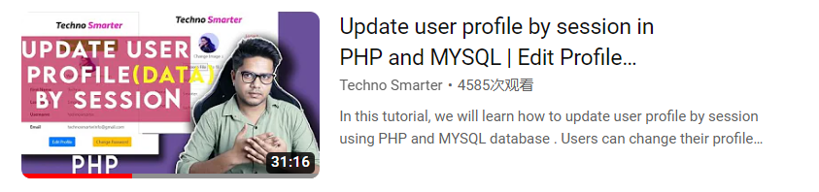
3. Go through your work in detail (code etc) [any extra experimentation, innovation I did]
/Lesson learnt

Slide 32
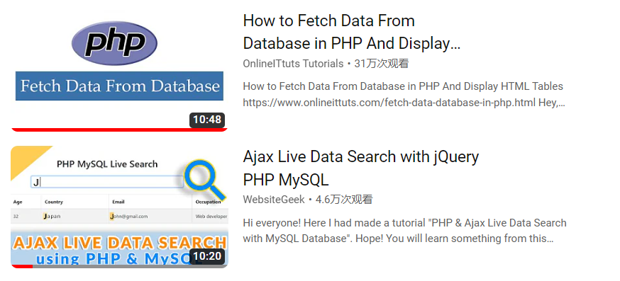
3. Go through your work in detail (code etc) [any extra experimentation, innovation I did]
/Lesson learnt

Slide 33
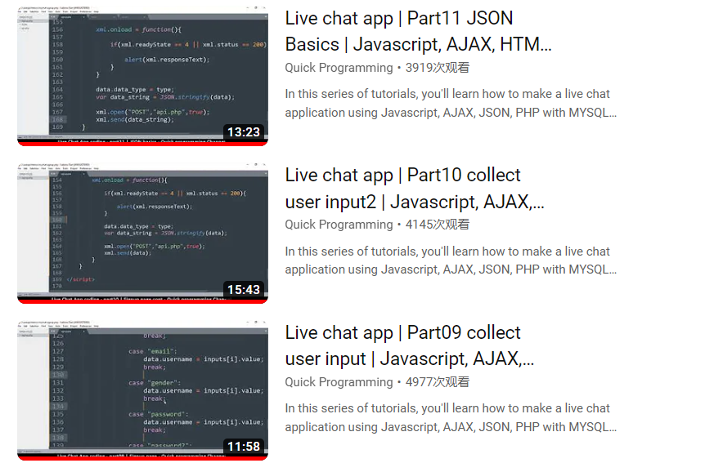
3. Go through your work in detail (code etc) [any extra experimentation, innovation I did]
/Lesson learnt

Slide 34
3. Go through your work in detail (code etc) [any extra experimentation, innovation I did]

Slide 35
3. Go through your work in detail (code etc) [any extra experimentation, innovation I did]
Furthur works:
To write about future works for front-end development, you can consider the following points:
Emerging technologies: Write about the emerging technologies that are likely to shape the future of front-end development. This may include technologies such as WebAssembly, Progressive Web Apps (PWAs), Virtual Reality (VR), Augmented Reality (AR), and Artificial Intelligence (AI).
Mobile-first design: With the growing number of mobile users, the front-end development approach is shifting towards mobile-first design. You can write about how this trend is likely to impact the future of front-end development.
Web accessibility: Write about how web accessibility is becoming increasingly important and how front-end developers need to consider accessibility issues in their designs.
Responsive design: Responsive design has been a trend for some time now, but it will continue to be important in the future as more people access websites on a variety of devices.
Cross-platform development: With the increasing popularity of mobile devices and the need for cross-platform compatibility, you can write about how front-end developers will need to consider cross-platform development strategies.
Microservices: Write about how microservices architecture is becoming popular in web development, and how front-end developers will need to adapt to this trend.
User experience: As user experience becomes increasingly important, front-end developers will need to focus on designing websites that are intuitive, easy to use, and visually appealing.
Performance optimization: In the future, front-end developers will need to focus on optimizing website performance to ensure fast load times and smooth user experience.
By considering these points, you can write a comprehensive and informative article on the future of front-end development.

